Slide 1

Database Management Systems
Shamim Ahmad

Slide 2
Transaction

Slide 3
Transaction Example:
Suppose, Mr. A and Mr. Y have a bank account. Now need to transfer 1000 taka from Mr. A accounts to Mr. Y accounts.
Transaction:
Read (Mr.A)
Mr.A = Mr.A -1000
Write (Mr.A)
Read (Mr.Y)
Mr. Y = Mr.Y +1000
Write (Mr.Y)
COMMIT
Database
Server

Slide 4
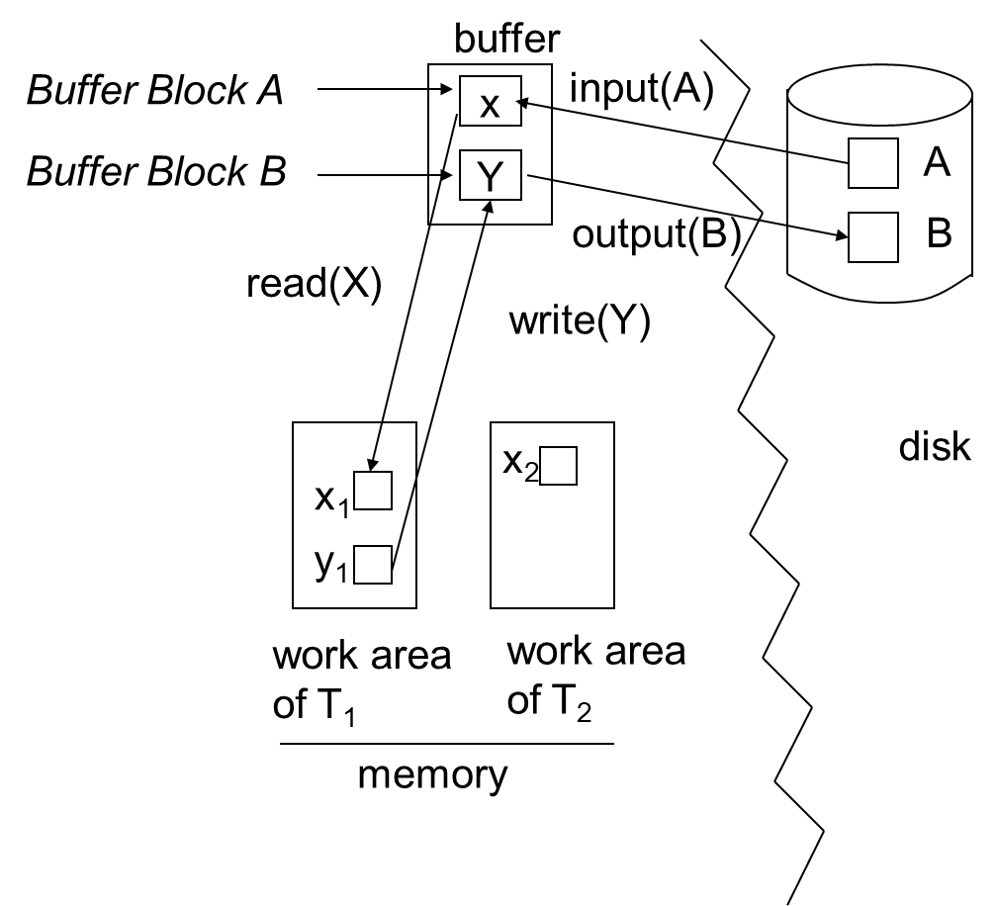

Slide 5
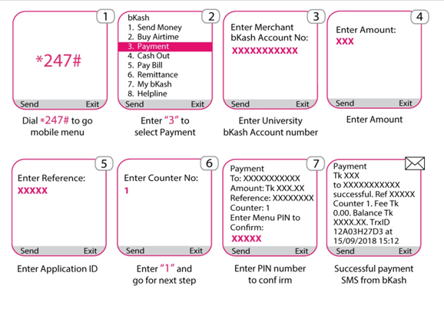
Transaction example (Cont’d):

Slide 6
Transaction Concept
A transaction is a unit of program execution that accesses and possibly updates various data items.
E.g. transaction to transfer €50 from account A to account B:
1. read_from_acoount(A)
2. A := A – 50
3. write_to_account(A)
4. read_from_accont(B)
5. B := B + 50
6. write_to_account(B)
Two main issues to deal with:
Failures of various kinds, such as hardware failures and system crashes
Concurrent execution of multiple transactions

Slide 7
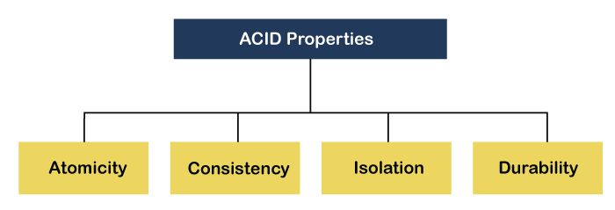
ACID Properties
In order to maintain consistency in a database, before and after the transaction, certain properties are followed. These are called ACID properties.

Slide 8
Transaction ACID properties
E.g. transaction to transfer €50 from account A to account B:
1. read_from_acoount(A)
2. A := A – 50
3. write_to_account(A)
4. read_from_accont(B)
5. B := B + 50
6. write_to_account(B)
Atomicity requirement
if the transaction fails after step 3 and before step 6, money will be “lost” leading to an inconsistent database state
Failure could be due to software or hardware
the system should ensure that updates of a partially executed transaction are not reflected in the database
All or nothing, regarding the execution of the transaction
Durability requirement — once the user has been notified of transaction has completion, the updates must persist in the database even if there are software or hardware failures.

Slide 9
Transaction ACID properties (Cont.)
Transaction to transfer €50 from account A to account B:
1. read_from_acoount(A)
2. A := A – 50
3. write_to_account(A)
4. read_from_accont(B)
5. B := B + 50
6. write_to_account(B)
Consistency requirement in above example:
the sum of A and B is unchanged by the execution of the transaction
In general, consistency requirements include
Explicitly specified integrity constraints such as primary keys and foreign keys
Implicit integrity constraints
e.g. sum of balances of all accounts, minus sum of loan amounts must equal value of cash-in-hand
A transaction must see a consistent database and must leave a consistent database
During transaction execution the database may be temporarily inconsistent.
Constraints to be verified only at the end of the transaction

Slide 10
Transaction ACID properties (Cont.)
Isolation requirement — if between steps 3 and 6, another transaction T2 is allowed to access the partially updated database, it will see an inconsistent database (the sum A + B will be less than it should be). T1 T2
1. read(A)
2. A := A – 50
3. write(A) read(A), read(B), print(A+B)
4. read(B)
5. B := B + 50
6. write(B
Isolation can be ensured trivially by running transactions serially
that is, one after the other.
However, executing multiple transactions concurrently has significant benefits, as we will see later.

Slide 11
ACID Properties - Summary
A transaction is a unit of program execution that accesses and possibly updates various data items.To preserve the integrity of data the database system must ensure:
Atomicity Either all operations of the transaction are properly reflected in the database or none are.
Consistency Execution of a (single) transaction preserves the consistency of the database.
Isolation Although multiple transactions may execute concurrently, each transaction must be unaware of other concurrently executing transactions. Intermediate transaction results must be hidden from other concurrently executed transactions.
That is, for every pair of transactions T_{i} and T_{j}, it appears to T_{i} that either T_{j}, finished execution before T_{i} started, or T_{j} started execution after T_{i} finished.
Durability. After a transaction completes successfully, the changes it has made to the database persist, even if there are system failures.

Slide 12
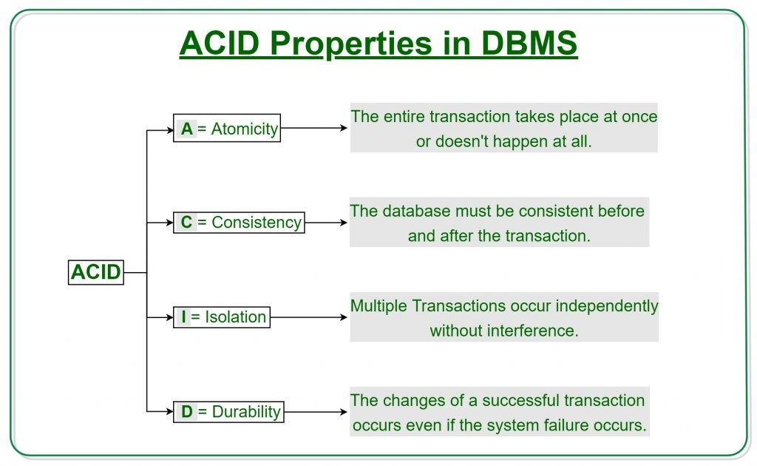

Slide 13
Non-ACID Transactions
There are application domains where ACID properties are not necessarily desired or, most likely, not always possible.
This is the case of so-called long-duration transactions
Suppose that a transaction takes a lot of time
In this case it is unlikely that isolation can/should be guaranteed
E.g. Consider a transaction of booking a hotel and a flight
Without Isolation, Atomicity may be compromised
Consistency and Durability should be preserved
Usual solution for long-duration transaction is to define compensation action – what to do if later the transaction fails
In (centralized) databases long-duration transactions are usually not considered.
But these are more and more important, specially in the context of the Web.

Slide 14
 | A | C | I | D
read_from_acoount(A)
A := A – 50
write_to_account(A)
read_from_accont(B)
B := B + 50
write_to_account(B)

Slide 15
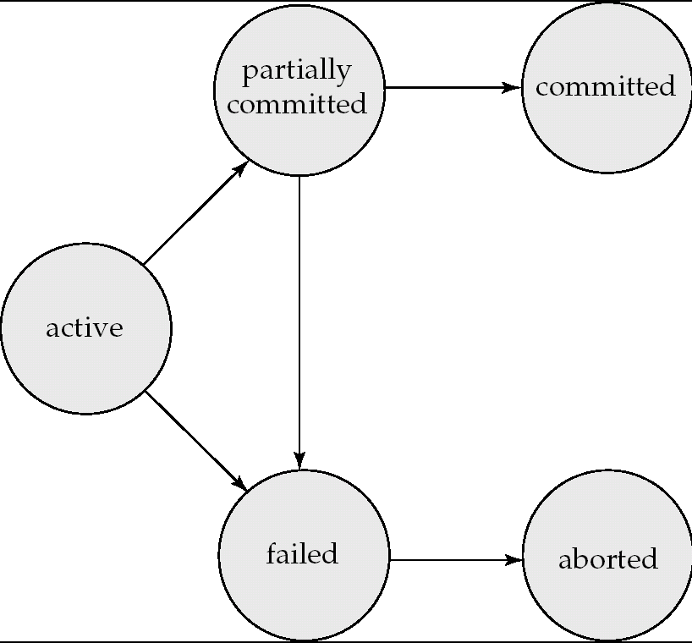
Transaction State (Cont.)

Slide 16
Transaction State
Active – the initial state; the transaction stays in this state while it is executing
Partially committed – after the final statement has been executed.
Failed – after the discovery that normal execution can no longer proceed.
Aborted – after the transaction has been rolled back and the database restored to its state prior to the start of the transaction. Two options after it has been aborted:
restart the transaction
can be done only if no internal logical error
kill the transaction
Committed – after successful completion.
To guarantee atomicity, external observable action should all be performed (in order) after the transaction is committed.

Slide 17
Committed Transactions
A committed transaction that has performed updates transforms the database into anew consistent state, which must persist even if there is a system failure.
It cannot undo its effects by aborting it
The only way to undo the effects of a committed transaction is to execute a compensating transaction.

Slide 18
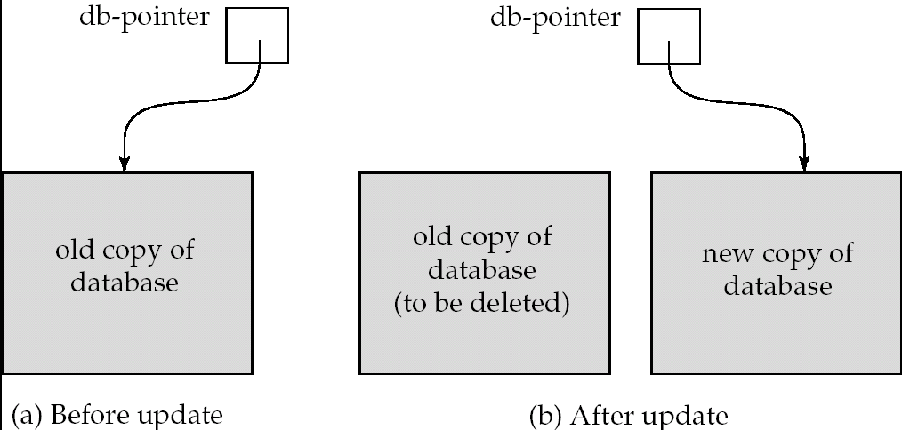
Implementation of Atomicity and Durability
The recovery-management component of a database system implements the support for atomicity and durability.
E.g. the shadow-database scheme:
all updates are made on a shadow copy of the database
db_pointer is made to point to the updated shadow copy after
the transaction reaches partial commit and
all updated pages have been flushed to disk.

Slide 19
Implementation of Atomicity and Durability
The recovery-management component of a database system implements the support for atomicity and durability.
E.g. the shadow-database scheme:
all updates are made on a shadow copy of the database
db_pointer is made to point to the updated shadow copy after
the transaction reaches partial commit and
after the operating system has written all the pages to disk

